Slide 1
Tracheostomy & Laryngectomy update 2026

Slide 2
contents
Tracheostomy update
  Bedside equipment
  Shiley sizing
  Shiley XL
  Bivona
  Passey Muir valve and/or capping
  Trach care
  Changing a trach tube
The difference between tracheostomy and laryngectomy
Laryngectomy emergencies
Laryngectomy tube care and maintenance
Educating the laryngectomy patient

Slide 3
Trachesotomy update 2026

Slide 4
Answers to your questions are important
Feel free to ask questions or comment as we go.

Slide 5
Tracheostomy bedside equipment
Suction set-up
Suction catheters
Same size trach
Smaller size trach
Ambu bag & Mask
CO2 Detector
Spare inner cannulas
Suture removal kit (if applicable)
Obturator taped over bed
Trach care kits
Oxygen flowmeter
Extra Velcro trach holder

Slide 6
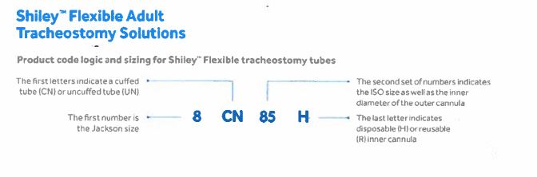
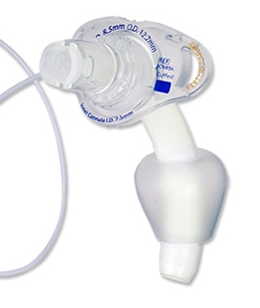
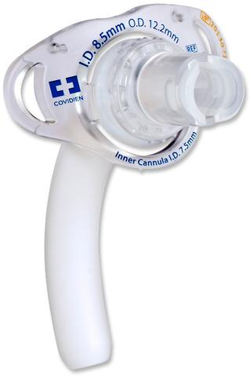
Shiley sizing
COLOR CODED
SIZE | CUFFED | UNCUFFED
4 | 4CN65H | 4UN65H
6 | 6CN75H | 6UN75H
8 | 8CN85H | 8UN85H

Slide 7
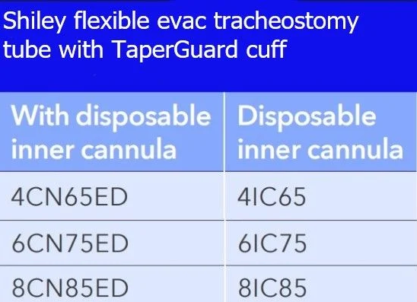
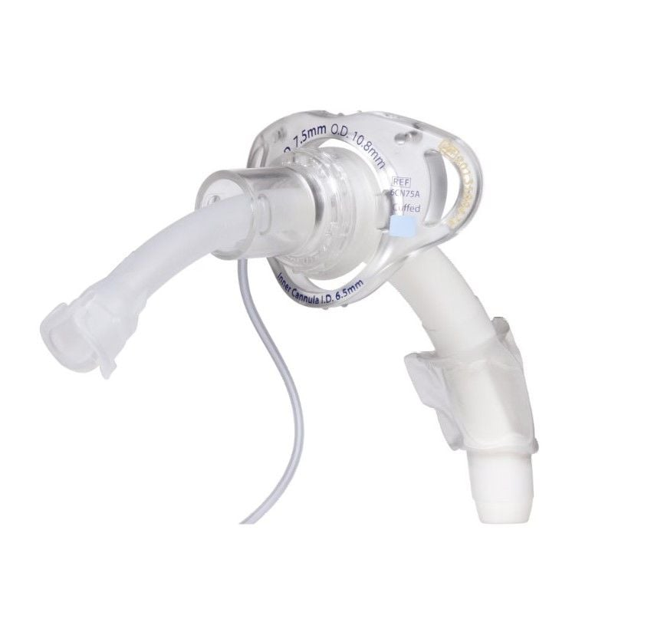
Inner cannula diameters are 1 mm less than trach inner diameter. Example: 8.5 I.D. trach has a 7.5 I.D. inner cannula (Blue)

Slide 8
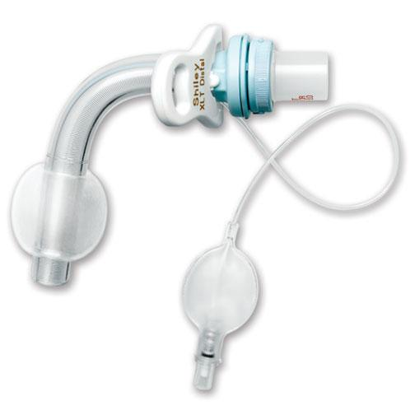
Shiley XL
Proximal length
2 Types:
  Poximal & Distal (where’s the extra length)
  Cuffed of cuffless
  Disposable inner cannula
Distal length

Slide 9
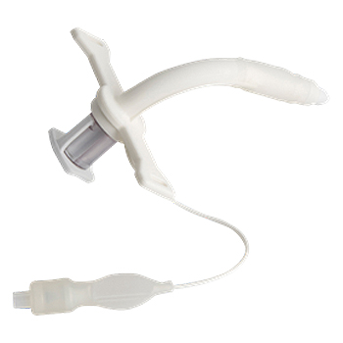
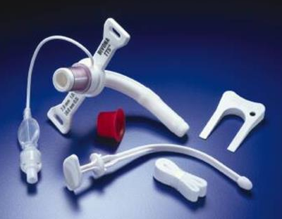
Bivona TTS (tight to shaft)
Flexible silicone trach
Inflate cuff with water
No inner cannula

Slide 10
Quiz: When should a cuff be inflated?
At all times…in part, to help prevent aspiration.
Only when on the ventilator
When using a cap or passey muir speaking valve.
By “anchoring” the trach, an inflated cuff impairs the swallow mechanism which actually increases the possibility of aspiration!
The correct answer. Cuff optionally can be left deflated in BiPAP though.
Hope nobody thought that this was the answer!

Slide 11
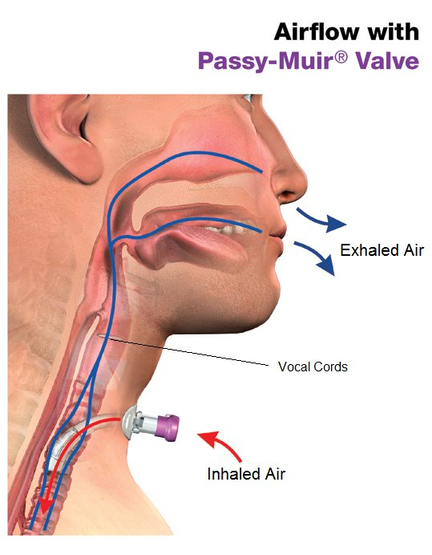
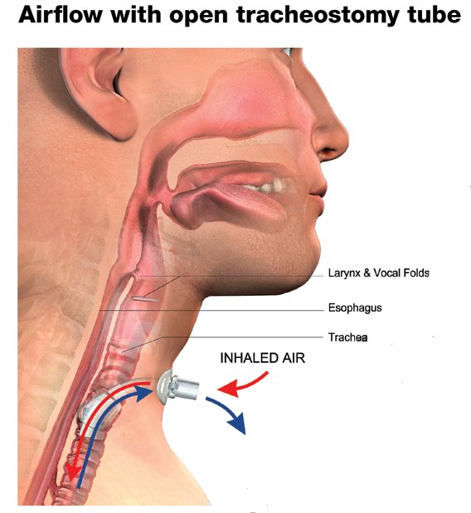
Passey Muir valve
Cuff Deflated

Slide 12
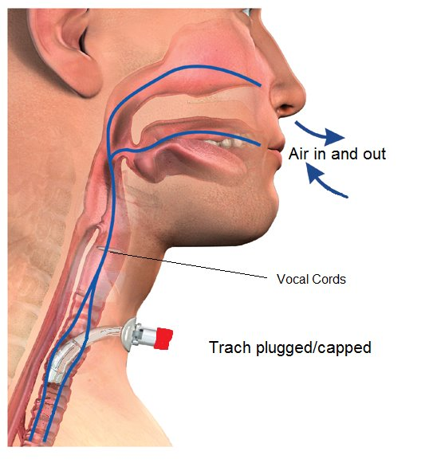
Capped
Cuff Deflated

Slide 13
Trach care: Q shift
Clean around the trach with sterile water
Suction the patient
Change the inner cannula
Change split gauze if necessary
Change the Velcro trach holder

Slide 14
Changing a trach tube

Slide 15
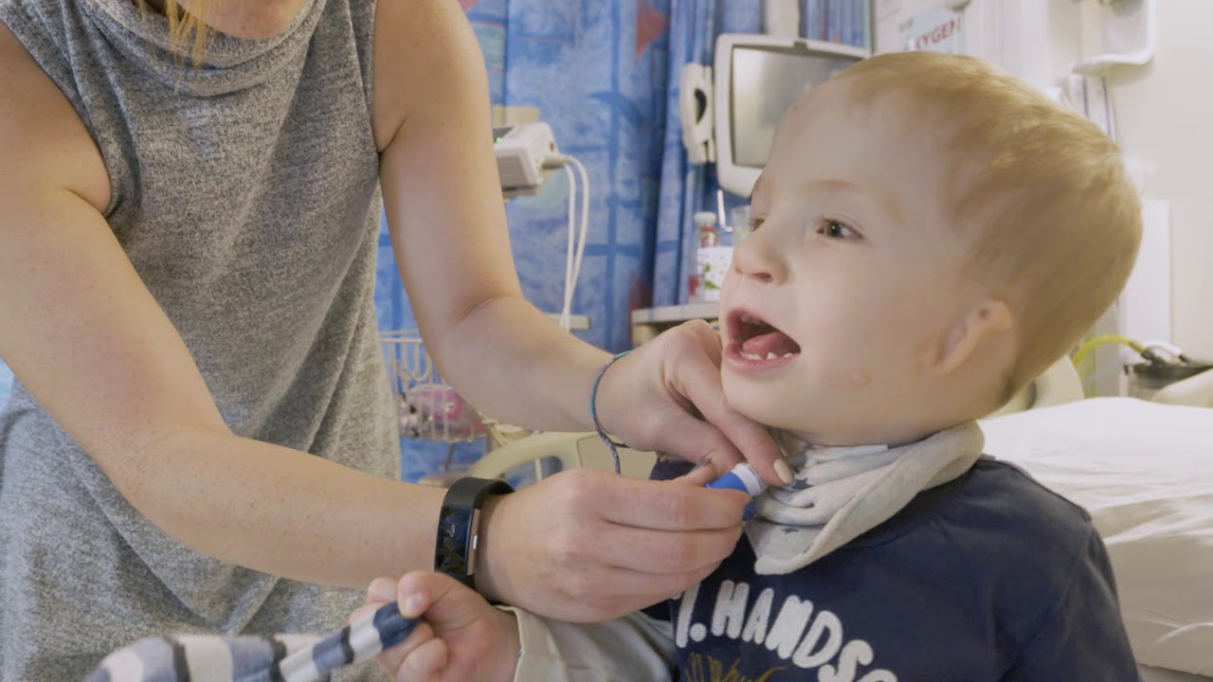
Changing a trach tube
Preparation
Gather supplies: Match the new trach tube in size, style, and brand to the current one (plus keep a spare one size smaller nearby). Get an obturator, water-soluble lubricant, trach ties or Velcro straps, clean gloves, suction equipment, and a syringe (if the tube has a cuff). ETCO2 detector
Check the new tube: Test the cuff (if present) for leaks, then deflate it completely. Insert the obturator into the outer cannula.
Lubricate the tip: Apply a small amount of water-soluble lubricating jelly to the tip of the new tube and obturator.
Position the patient: Place the patient on their back with the neck slightly extended (often using a small roll under the shoulders) so the stoma is clearly visible. Suction the trach if needed.

Slide 16
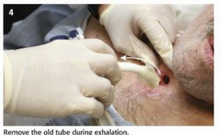
Removing the Old Tube
Hold the old tube: Keep a steady hand on the old tracheostomy tube so it does not dislodge accidentally.
Release the ties: Cut or unfasten the old trach ties or Velcro strap. Deflate the cuff if the tube is cuffed.
Withdraw the tube: Take a deep breath (or ensure the patient is supported), then pull the old tube out smoothly following the natural curve of the trachea.
Clean the area: Clean and dry the skin and stoma site with moistened gauze. [1, 2, 3, 4, 5]

Slide 17
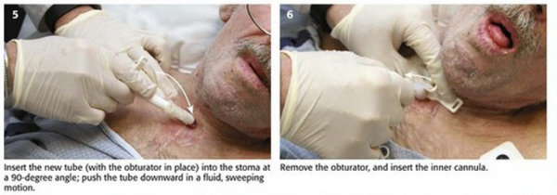
Inserting the New Tube
Insert along the curve: Gently slide the new, lubricated tracheostomy tube (with obturator inside) into the stoma following the downward and backward curve of the airway.
Remove the obturator: Immediately pull the obturator straight out once the tube is seated so the patient can breathe through the tube.
Insert the inner cannula: Place the inner cannula into the outer cannula and lock it into place. Check for presence of CO2 using ETCO2 or Capnograph
Secure the tube: Fasten the new trach ties or Velcro strap securely around the neck, checking that you can comfortably fit one or two fingers beneath the band.
Inflate and check: Inflate the cuff (if ordered), reconnect any oxygen or ventilator circuits, and check for equal air movement, proper breathing pattern, and good

Slide 18
Questions? Concerns?
Comments?

Slide 19
The difference between trach and laryngectomy

Slide 20
Trach vs Laryngectomy
Trachesotomy
Indicated for maintenance of ventilatory support by lowering resistance, deadspace, and provide access for bronchial hygiene.
Reversible
Airway necessary to prevent closure of surgical opening
Speaking accomplished through speaking valve
Laryngectomy
Removal of the larynx indicated in certain cancers involving the throat.
Irreversible
Permanent opening does not require an airway after the surgical site has healed.
Speaking can only be accomplished with additional mechanical devices
  Electrolarynx
  Esophageal speech
  Tracheo-esophageal puncture with a voice prosthetic

Slide 21
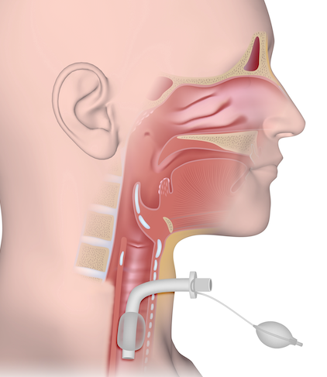
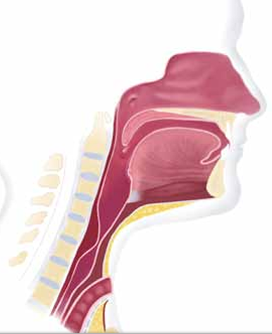
Tracheostomy
Laryngectomy
No tracheal connection to upper airway!
Airway opening

Slide 22
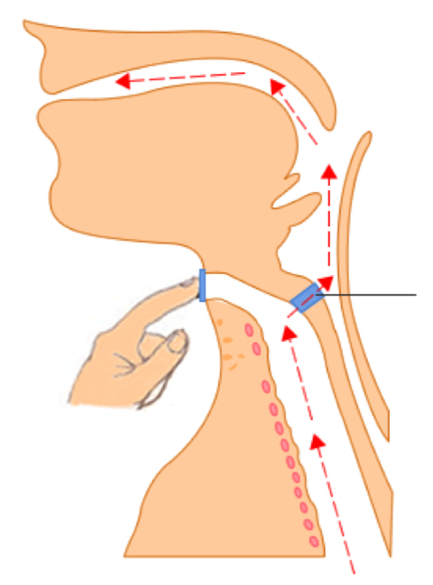
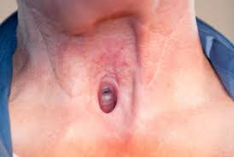
Voice prosthetic
Two parts: 1) tracheoesophageal channel
2) Button

Slide 23
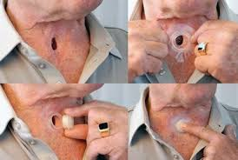

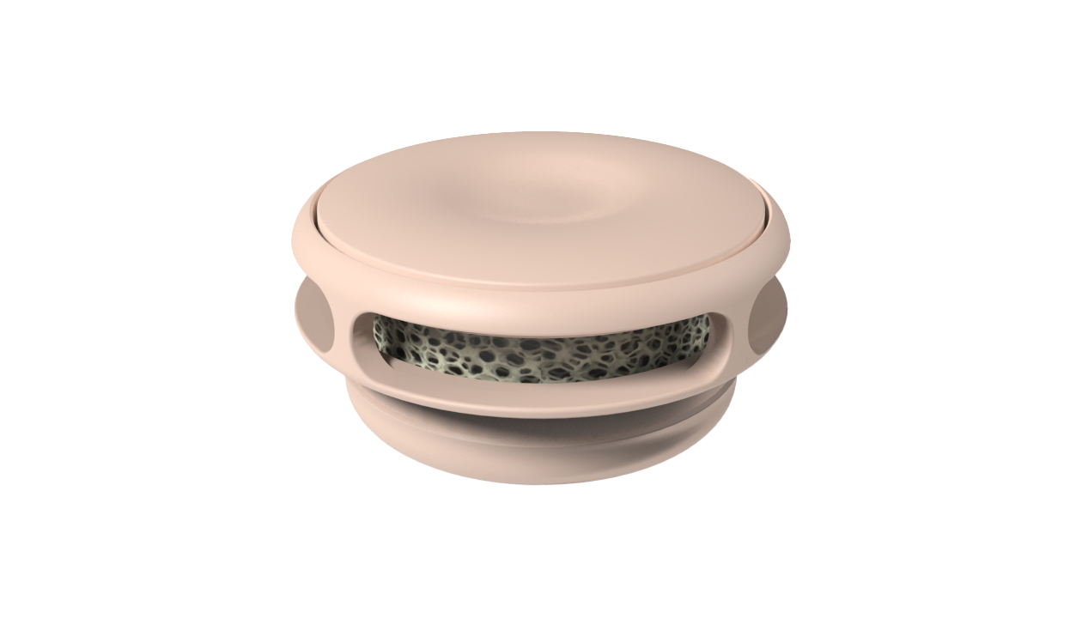
Includes a Built-in HME

Slide 24
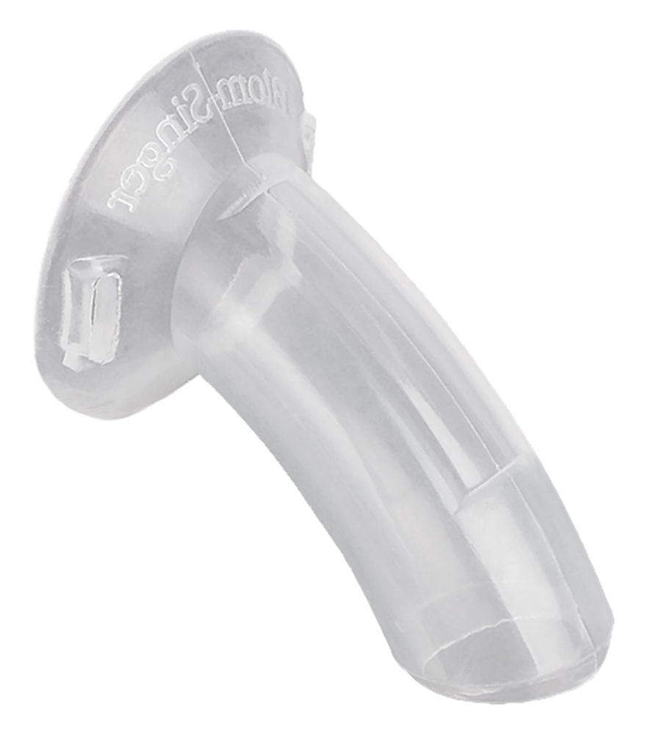
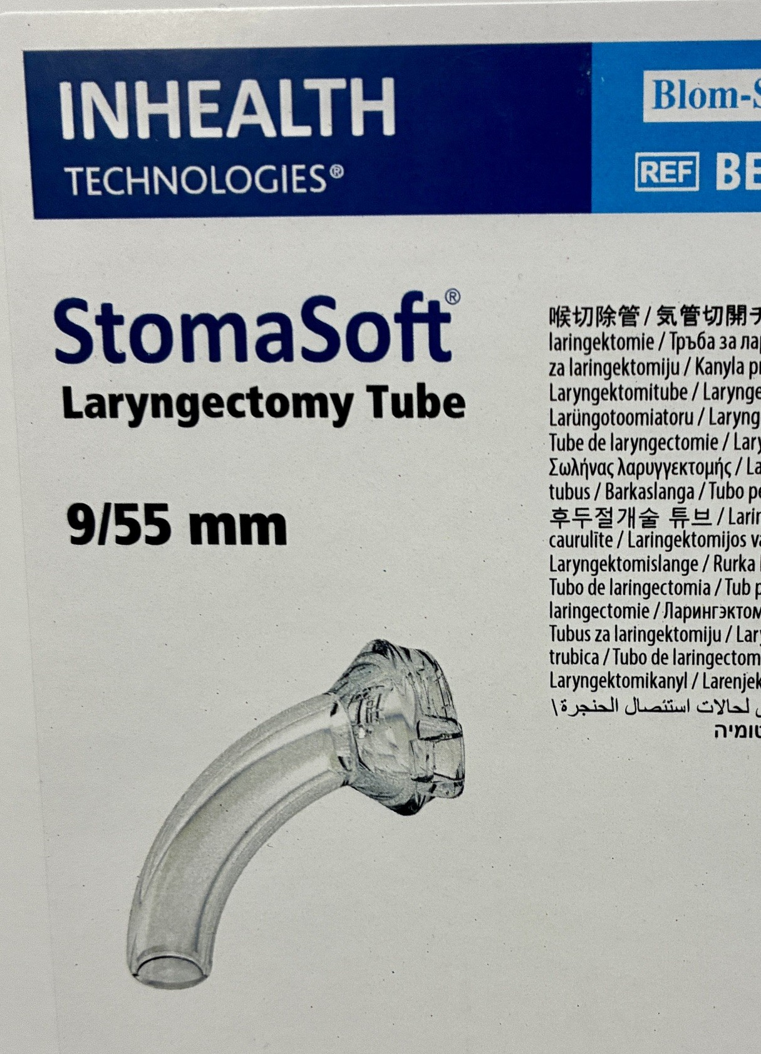
What is a Laryngectomy Tube? “Lary”
A lary tube is a flexible silicone tube designed to maintain the stoma right after the laryngectomy surgery.
We have sizes 9-12

Slide 25
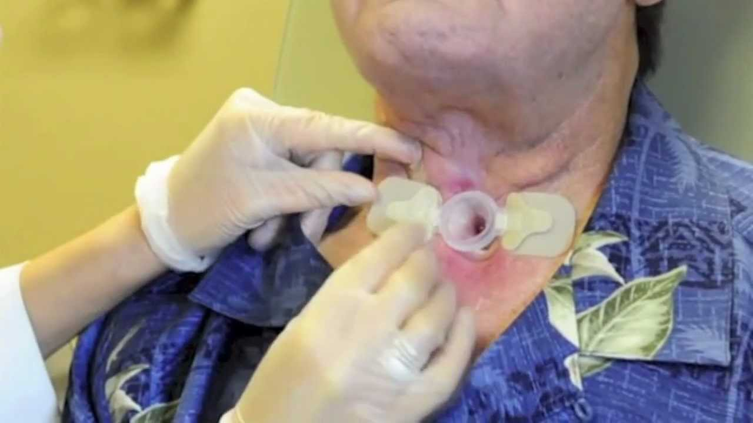
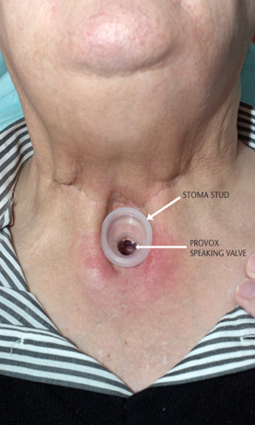
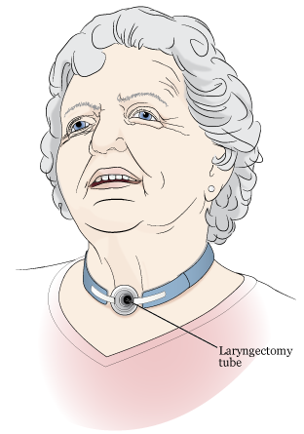
Identification of a “Lary Tube”

Slide 26
Resucitation of the laryngectomy patient

Slide 27
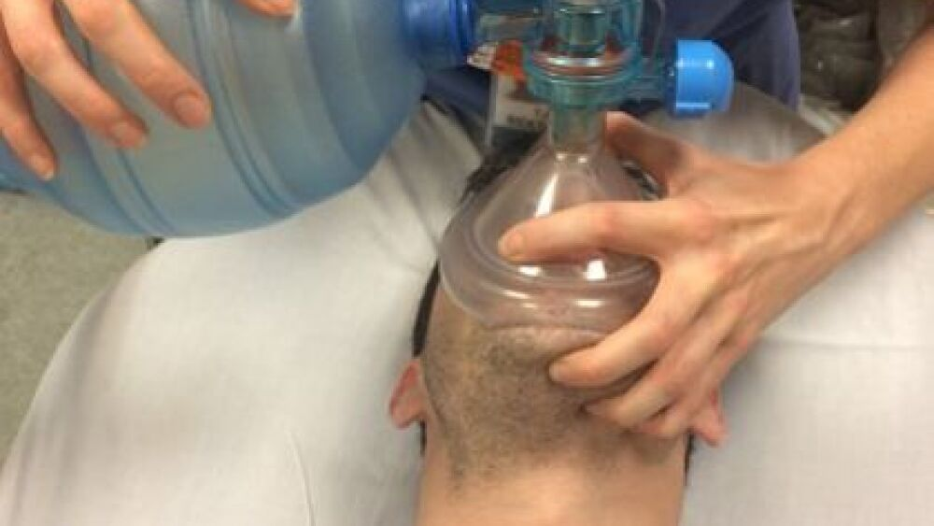
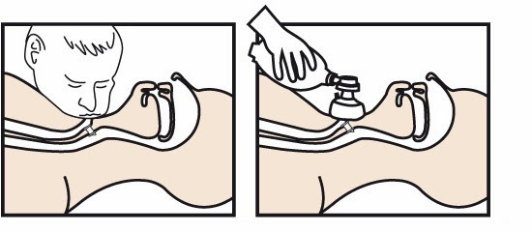
Manual resuscitation:
Do not bag & Mask ventilate the face of a laryngectomy patient

Slide 28
Steps for manual ventilation of the laryngectomy patient:
Look at the neck
Is there a stoma?
NO
Bag & Mask to mouth and nose
Yes
Remove Lary tube or button if present
Bag
Yes
Is there a trach?
NO
Bag open stoma
Place an ETT in open stoma: may require 6.0

Slide 29
Manual Ventilation of the stoma
https://www.youtube.com/watch?v=aU19N1rEUIc

Slide 30
Laryngectomy care

Slide 31
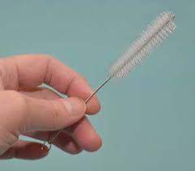
How to Remove, Clean, and Reinsert a Laryngectomy Tube
Clean the laryngectomy tube regularly to help to keep it free of secretions. We recommend cleaning it at least once a shift or more often as needed.
Gather your supplies. You’ll need:
  Sterile Water
  A nylon tracheostomy brush
  Normal saline
  Cotton-tipped applicators
  Water soluble gel
  Clean, dry gauze pads

Slide 32
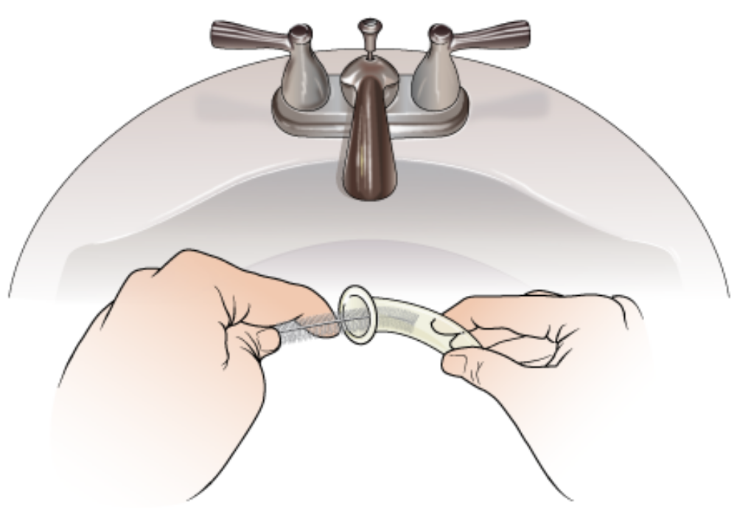
How to Remove, Clean, and Reinsert a Laryngectomy Tube
2. Wash your hands well with soap and water.
3. Cut or untie the neck tape.
4. Remove the tube from the stoma.
5. Rinse with sterile water
6. Use the nylon brush to clean the inside of the laryngectomy tube
7. Rinse with sterile water

Slide 33
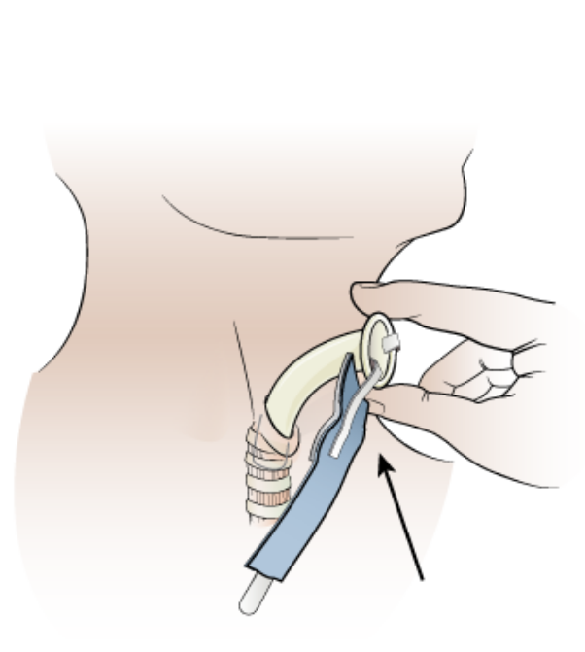
How to Remove, Clean, and Reinsert a Laryngectomy Tube
8. Once the tube is clean, shake out the extra water. Dry the tube with a gauze pad.
9. Put clean neck tape in the slots on the side of the tube.
10. Gently clean the skin around your stoma with normal saline using cotton-tipped
applicators.
11. Tilt the head back slightly in order to expose the stoma.
12. Reinsert the Lary tube.
13. Water soluble gel may be used for reinsertion
14. Tie the neck tape leaving 1 finger space between
the tape and the neck.

Slide 34
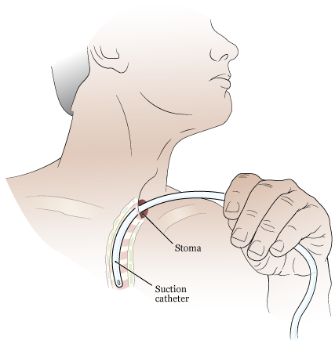
Educating the Laryngectomy patient : keeping the airway clear
Keeping the airway clear of sputum is important to help prevent infection due to retained secretions.
Whenever possible, it is recommended to avoid suctioning by learning to cough up the secretions on your own. Drops of normal saline may be used to loosen and mobilize secretions.
If mucus becomes exceedingly thick and hard to cough up on your own, suctioning may be required.
You can learn to suction yourself provided that you have all of the necessary equipment.

Slide 35

Cleaning the stoma and lary tube if present
You will need to follow your discharge instructions on care and maintenance of your stoma.
There is lots of good resources available on the internet like the instructions from Memorial Sloan Kettering Cancer Center on “Caring for Your Laryngectomy Stoma” https://www.mskcc.org/cancer-care/patient-education/caring-and-suctioning-your-laryngectomy-stoma

Slide 36
Questions?
Concerns?
Comments?

Slide 37
THANK YOU
Special thanks to Memorial Sloan Kettering Cancer Center for providing patient education materials.

